Slide 1
INORDER TRAVERSING Of TREE
Algorithm, Implementation & Analysis
Submitted By :Noyon Chandra Das
Student’s ID : 2411076140
Course : Data Structure
Department : Department of Computer Science & Engineering
University : University of Rajshahi
Date: 26 November, 2025

Slide 2
Presentation Roadmap
Introduction
What is Tree & Tree Traversing?
Traversing of Linear Data Structure Vs Traversing of Tree
Inorder traversing Algorithm (Steps)
Inorder traversing Smulation
Complexity Analysis (Time & Space)
Real-World Applications of Inorder traversing
Conclusion & Final Takeaways

Slide 3
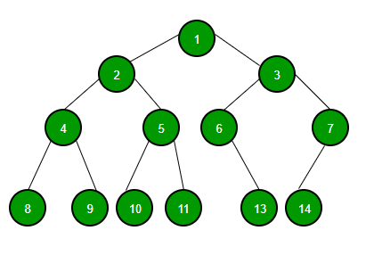
Introduction
What is Tree?
Tree is a non-linear collection of data item called node where is nodes connected by edge.
Root
Left
Sub-tree
Right Sub-tree
​What is Tree Traversal?
Tree Traversing means visiting each node of a tree.

Slide 4
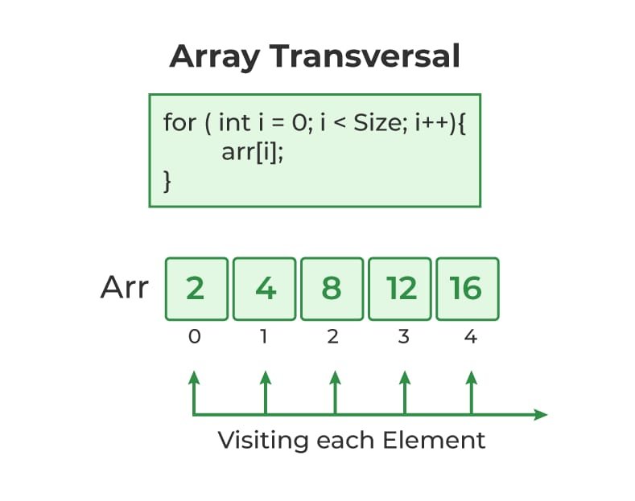
What is Tree Traversing?
Tree Traversing means visiting each node of a tree.
Traversing of Linear Data Structure Vs Traversing of Tree
Traversing of Linear Data Structure
In linear data structure like stack ,queue, array etc. have only one way of traversing .

Slide 5
Traversing of Tree
The tree has various way to traverse each node .On the basis of root node the tree traversing can be classified into 3 types :
1. Pre-order
2.In-order
3.Post-order

Slide 6
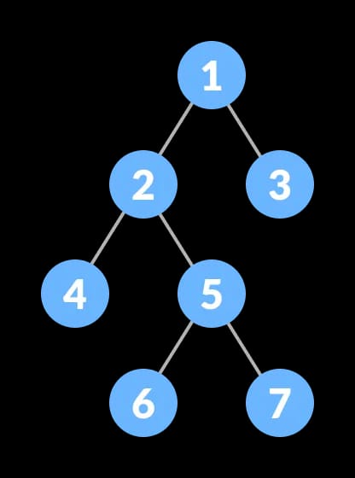
Algorithm of In-Order Tree Traversing
Step-1:Begin
Step-2:Process the left sub-tree element
Step-3:Process the root node
Step-4:Process the right sub-tree element
Step-5:Exit
In Short :
Left ⟶Root⟶Right

Slide 7
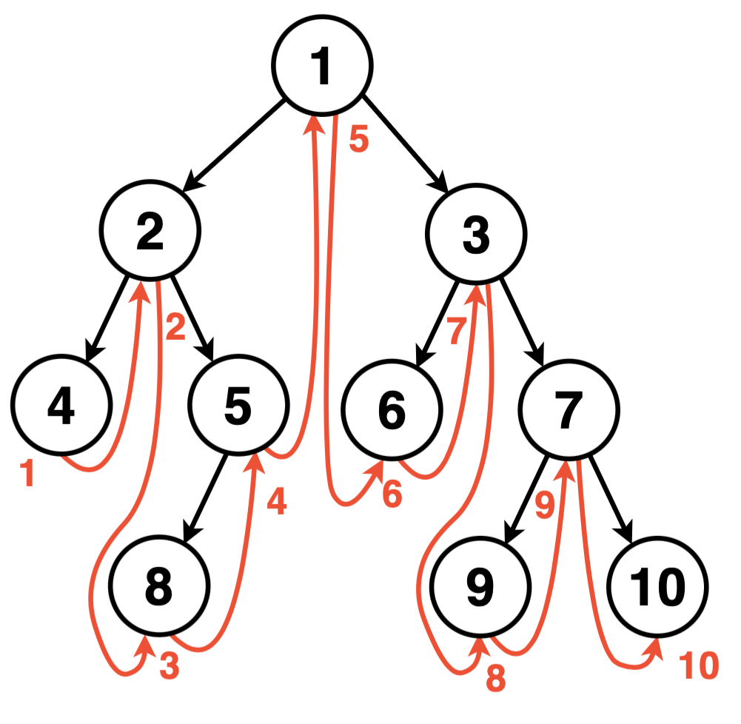
Simulation of In-order Traversing
4
2
8
5
1
6
3
9
7
10

Slide 8
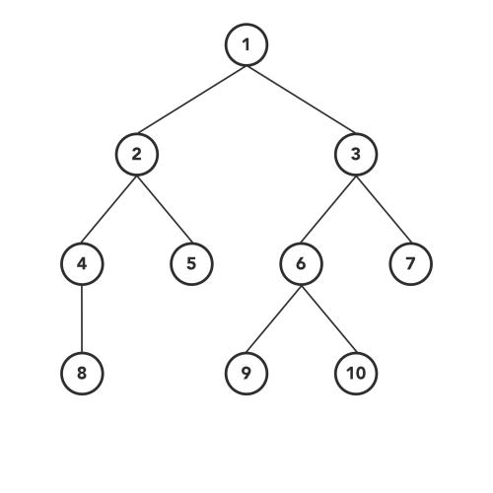
Simulation of In-order Traversing

Slide 9
Complexity Analysis (Inorder Traversing)
Time Complexity: O(n)
Why?
✔ Reason: We visit every node exactly once (where n is the number of nodes).
2) Space Complexity: O(h) (where h is the height of the tree).
3) Worst Case: O(n) (Skewed Tree - like a linked list).
​4) Average Case: O(log n) (Balanced Tree).
​ Reason: Stack memory usage during recursion.

Slide 10
Applications of In-Order Traversing
Binary Search Trees (BST): Used to get elements in non-decreasing order (Sorting).
2. Expression Trees: Inorder traversal gives the "Infix" expression (e.g., A + B).
3. Threaded Binary Trees: Used to optimize traversal without recursion/stack.
4. System Design: Database indexing often relies on tree structures where in-order reading is required for range queries.

Slide 11
Summary & References
What We Learned from Inoder Traversing
Recap:
✔ Follows Left → Root → Right.
✔ The best way to retrieve sorted data from a BST
✔ Efficient O(n) time complexity.
References
Cormen et al. (CLRS) – Introduction to Algorithms
GeeksforGeeks / LeetCode – BFS Practice Problems
VisualAlgo.net – Interactive Tree Animations

Slide 12
Thank You

